Slide 1


coredataengineers
DATA ENGINEERING FUNDAMENTALS
The journey starts here……..
BY NAJEEB SULAIMAN

Slide 2




ABOUT ME
Introduction
I am a professional data engineer with years of experience working across industries. I currently work as a data engineer at JLR in the United Kingdom, where I implements data solutions to support the manufacturing of luxury vehicle brands like Range Rover. I am the founder of the Data Engineering Community, a community founded with the vision of providing data engineers a supportive and collaborative platform.
Facilitator
najeebsulaiman_
Najeeb sulaiman

Slide 3
Table Of Content
Content List
01.
02.
03.
Introduction to Data Engineering
Data Engineering Lifecycle
Data Pipelines
04.
05.
06.
Data Modeling
Programming for Data Engineering
Cloud
07.
08.
Soft Skills
Case Studies

Slide 4
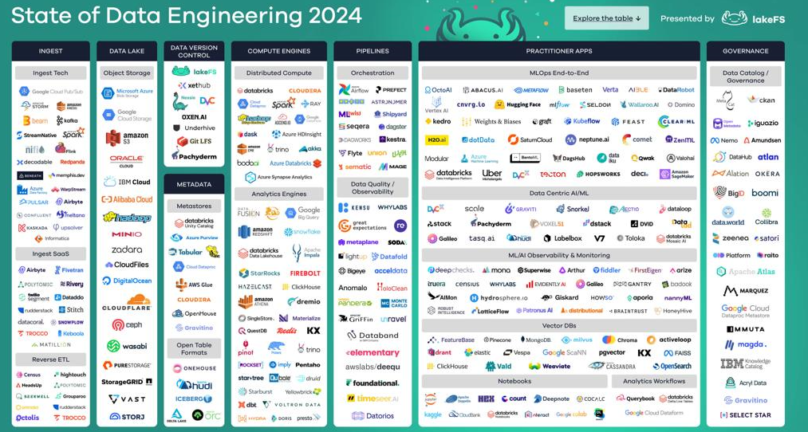
coredataengineers
What do you think data engineering is?
Can you make sense of these enormous tools and technologies you need to learn as a data engineer?

Slide 5
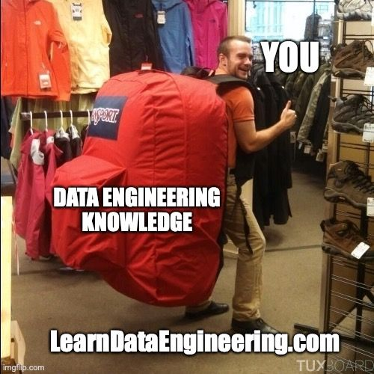
Why DE Fundamentals?
Data engineering is not well defined
No standardization of skills and knowledge
Way too much focus on technologies
Too much vendor marketing noise. Lot's of confusion for data engineers
New tools every market days

Slide 6
coredataengineers
What does not change?
The fundamentals of data engineering
In 5 years
Are systems going to stop generating data?
Will there be no need to ingest data?

Slide 7
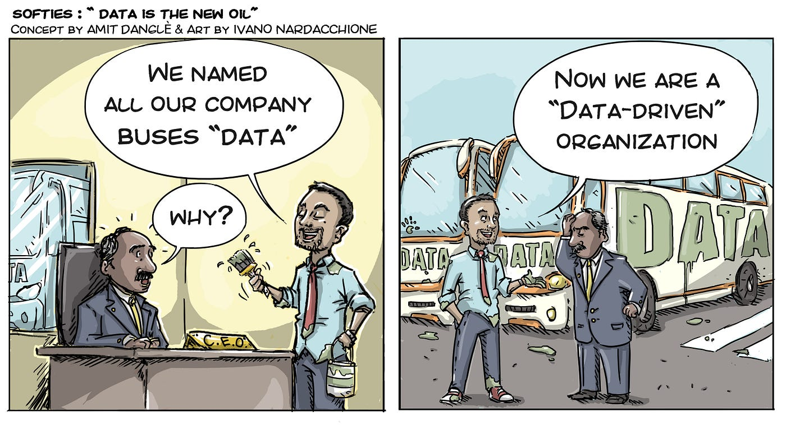
What Data Engineering is not
Data engineering is not ETL Development
Data engineering is not Devops
Data engineering is not DBA
Data engineering is not Software Engineering
Data engineering is not Cloud Engineering

Slide 8


Data Engineering
The development, implementation, and maintenance of systems and processes that take in raw data and produce high-quality, consistent information that supports downstream use cases, such as analysis and machine learning. Data engineering is the intersection of data management, DataOps, data architecture, orchestration, and software engineering.
In summary
Get data from sources, do something useful to it and serve it.
Data engineering is not just about technology. It is also about business.
Data engineering is indispensable
Data engineering is a title
Data engineering is foundational for "good" data outcomes. No quality analytics or AI/ML without DE.
Data engineering is lifecycle management

Slide 9
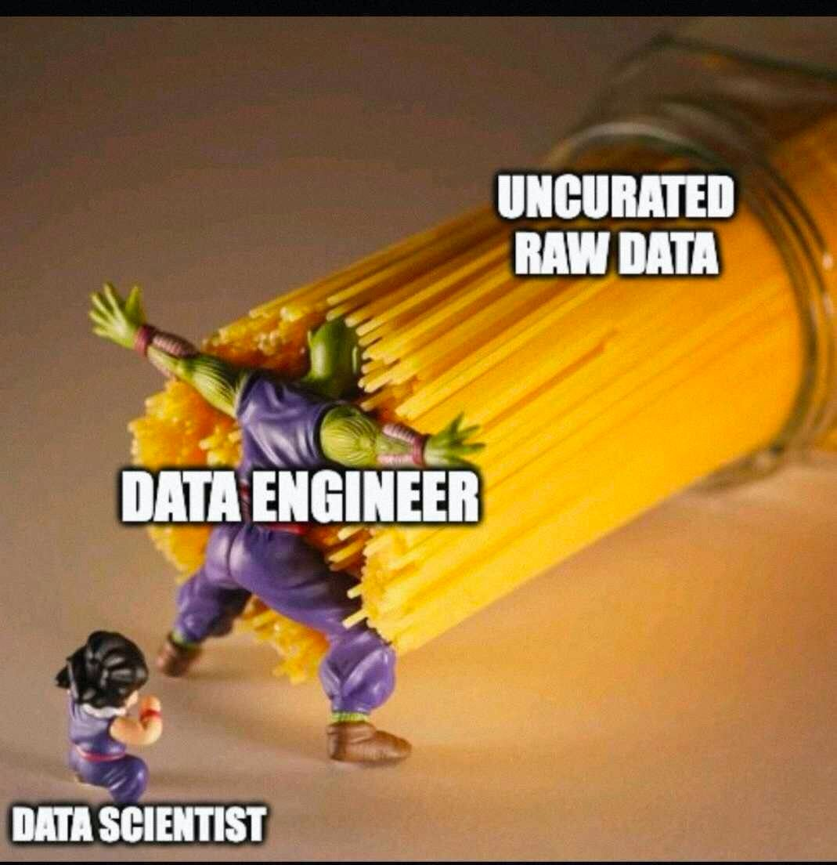
coredataengineers
Who is a data engineer?
A data engineer is a professional responsible for designing, building, and maintaining the infrastructure and systems that collect, store, process, and analyze large sets of data. Their primary role is to ensure that data is accessible, reliable, and efficiently processed for various applications, particularly for analytics and machine learning.

Slide 10


Roles and Responsibilities of a Data Engineer
Designing Data Pipelines
Data Collection and Ingestion
Data Transformation
Converting raw data into a usable format through cleaning, aggregation, and enrichment
Creating workflows that efficiently move data from source systems to storage and analytics platforms
Implementing processes to gather data from various sources including databases, APIs, and third-party services
Data Storage
Performance Optimization
Collaboration
Setting up and maintaining databases, data lakes, and data warehouses
Working with data scientists, analysts, and business stakeholders to understand data requirements and deliver solutions
Ensuring data systems are efficient, scalable, and performant.

Slide 11
Data Engineers Vs Data Scientists Vs Data Analysts
Data Engineers
Data Scientists
Data Analysts
Focus on building and maintaining the infrastructure required for data generation, storage, and processing
Concentrate on advanced analytics, statistical modeling, and machine learning to extract insights from data
Specialize in interpreting data and providing business insights through reporting and visualization

Slide 12
Impact of Data Engineering on Business Decisions
Data engineering forms the backbone of any data-driven organization. It ensures that data is accessible, reliable, and ready for analysis. By building robust data pipelines and storage solutions, data engineers enable data scientists and analysts to focus on deriving insights rather than dealing with data management issues.
Quality data engineering translates to accurate, timely, and actionable insights. This impacts business decisions in several ways.
Enhanced Decision-Making
Operational Efficiency
Scalability
01.
02.
03.
Reliable data allows businesses to make informed decisions based on accurate insights.
Automated data pipelines reduce manual data handling, saving time and reducing errors.
Well-designed data systems can scale with business growth, accommodating increasing data volumes without compromising performance.

Slide 13
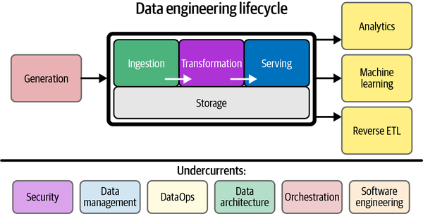
coredataengineers

Slide 14
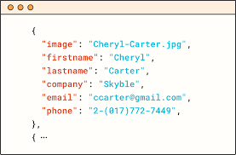
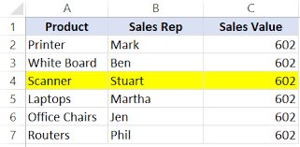
Data Sources / Generation
Data generation is the process of creating and collecting data through various techniques and methodologies.
Data engineers need to understand how source systems work, how they generate data, the frequency and velocity of the data, and the variety of data
they generate.
Structured Data
Semi-
Structured Data
Unstructured Data
01.
02.
03.
Data that is organized into predefined formats such as tables, with rows and columns.
Examples: SQL databases, spreadsheets.
Characteristics: Easily searchable, well-defined schema.
Data that does not conform to a rigid schema but still has some organizational properties.
Examples: JSON, XML.
Characteristics: Flexible schema, often hierarchical.
Data that lacks a predefined format or structure.
Text documents, images, videos, social media posts.
Requires advanced processing techniques for analysis.

Slide 15



Data Ingestion
Data ingestion refers to the tools and processes used to collect data from various sources and move it to a target destination.
Comparison
Latency:
Batch: High latency due to scheduled intervals.
Real-Time: Low latency with immediate processing
Real-Time Streaming
Continuously processing data as it is generated.
Batch Processing
Collecting and processing data in large volumes at scheduled intervals.
Complexity:
Batch: Simpler to implement and manage.
Real-Time: More complex, requires continuous monitoring.
Use Cases: Real-time analytics, monitoring systems, fraud detection.
Use Cases: Data warehousing, report generation, ETL processes.
Advantages:
Efficient for large volumes of data.
Can be scheduled during off-peak hours to optimize resource usage.
Disadvantages:
Delay in data availability.
Less suitable for real-time analytics.
Advantages:
Immediate data availability.
Suitable for time-sensitive applications.
Use Cases:
Batch: Historical data analysis, periodic reporting.
Real-Time: Live dashboards, event-driven applications.
Disadvantages:
Requires robust and scalable infrastructure.
Higher complexity in handling data streams.

Slide 16
Data Storage and management
Data storage and management in data engineering involves the processes and technologies used to store, organize, and maintain data so it can be efficiently retrieved and analyzed. This encompasses a wide range of activities, from the design of storage architectures to the implementation of data governance policies.
Relational Databases (RDBMS)
NoSQL Databases
Traditional databases such as MySQL, PostgreSQL, and Oracle that store data in tables and use SQL for querying.
Databases like MongoDB and Cassandra, that are designed to handle semi-structured data and provide flexibility in data models (document, key-value, graph).
Data Warehouses
Data Lakes
Centralized repository of integrated data from one or more disparate sources, designed for query and analysis.
Centralized repository for storing vast amounts of raw data in its native format.

Slide 17
Data Transformation
Data transformation involves modifying and processing data to make it usable and meaningful. This can include cleaning, enriching, aggregating, and restructuring data.
This is a crucial phase where raw data is converted into a format that is suitable for analysis, reporting, and other downstream processes.
Data Cleaning
Data Enrichment
Data Aggregation
01.
02.
03.
Handling Missing Values: Filling in missing data, removing records with missing values, or using default values.
Removing Duplicates: Identifying and eliminating duplicate records to ensure data accuracy.
Merging Data Sources: Combining data from multiple sources to create a more comprehensive dataset.
Adding Metadata: Supplementing data with additional context or information (e.g., geolocation data, demographic data).
Summarizing Data: Calculating aggregates such as sums, averages, counts, or other statistical measures.
Grouping Data: Grouping data by certain attributes to facilitate analysis (e.g., sales by region or time period).

Slide 18
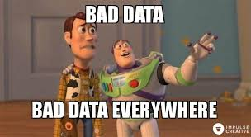
Example Scenario
Suppose a retail company wants to analyze its sales data. The raw data collected from different stores might have various issues like inconsistent date formats, missing values, and duplicate records. During the data transformation step, the company would:
Clean the data by removing duplicates and filling in missing values.
Standardize date formats to a common structure.
Enrich the data by adding information about the product categories.
Aggregate sales data to calculate total sales per region and time period.
Anonymize customer data to comply with privacy regulations.
Restructure the data to create a pivot table showing sales by product and region.

Slide 19

coredataengineers
Data Serving
This is the phase where processed and transformed data is made accessible and available for end-users, applications, and analytics tools. This step ensures that data is delivered in a format and manner that can be easily queried and utilized for decision-making, reporting, machine learning, and other business processes.
The data serving step is crucial for making processed data available in a secure, efficient, and scalable manner. It bridges the gap between data processing and data consumption, ensuring that end-users and applications can derive maximum value from the data.

Slide 20
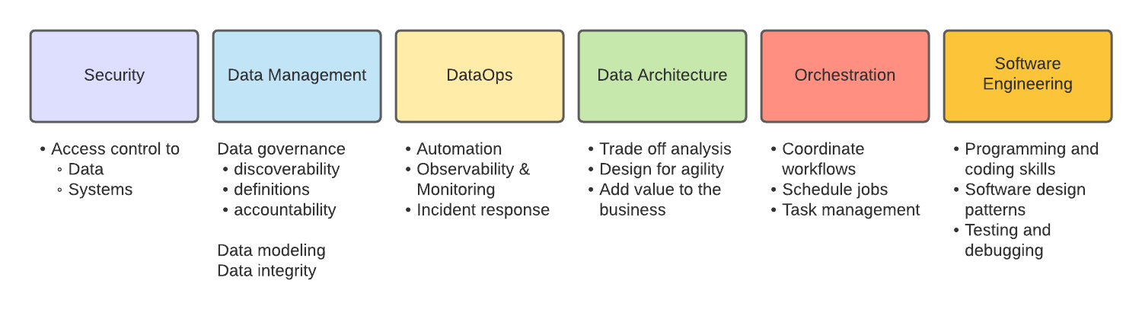
coredataengineers
The Undercurrents

Slide 21
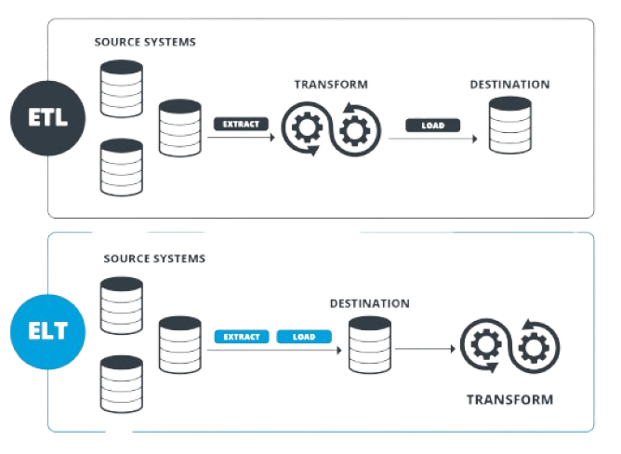
coredataengineers
What Is Data Pipeline
A data pipeline refers to the integrated set of processes, tools, and infrastructure set up to automate the flow of data from its various sources to its end destinations.

Slide 22

What is Data Modeling
Data modeling is the process of creating a visual representation of a whole or part of an information system to depict data structures and the relationships between them. This ensures data is structured in a way that supports efficient querying, analysis, and reporting.
Objectives of Data Modeling:
Facilitate Data Management: Provide a clear blueprint for designing databases that are easy to maintain and scale.
Enhance Data Quality: Define data standards and consistency.
Improve Performance: Optimize data retrieval and update processes.
Enable Better Decision-Making: Provide accurate and timely information through well-structured data.

Slide 23
Types of Data Models
Conceptual Data Model
Logical Data Model
Physical Data Model
01.
02.
03.
Definition: High-level overview of the data structures and their relationships, focusing on business requirements.
Components: Entities, relationships, high-level attributes.
Example: ERD (Entity-Relationship Diagram) depicting entities like Customer, Order, Product.
Definition: Detailed map of entities, attributes, and relationships, without concern for physical implementation.
Components: Entities, attributes, primary keys, foreign keys, relationships.
Example: ERD with tables, including primary and foreign keys.
Definition: Specific implementation of the logical model for a particular database management system (DBMS).
Components: Tables, columns, indexes, constraints, physical storage details.
Example: SQL schema with CREATE TABLE statements, indexes, and storage parameters.

Slide 24
Key Data Modeling Concepts
Relationships
One-to-One (1:1):
Each entity in the relationship will have exactly one related entity.
Example: Each employee has one employee ID.
Primary and Foreign Keys:
Entities and Attributes
Primary Key:
A unique identifier for a record in a table.
Example: CustomerID in the Customer table.
Entities:
Objects or things in the system that have distinct identities.
Example: Customer, Product, Order.
One-to-Many (1:M):
One entity can be associated with multiple entities.
Example: A customer can place many orders.
Foreign Key:
An attribute in one table that links to the primary key of another table.
Example: CustomerID in the Order table linking to CustomerID in the Customer table.
Many-to-Many (M:M):
Entities on both sides of the relationship can have multiple associations.
Example: Students can enroll in many courses, and courses can have many students.
Attributes:
Properties or details of an entity.
Example: Customer attributes might include CustomerID, Name, Address.

Slide 25
Programming Fundamentals
Programming skills are essential for automating data pipelines, manipulating large datasets, and integrating with various data systems.
Key languages: Python, SQL, and Bash scripting, each serving unique roles in data engineering tasks.
Python
SQL
Bash Scripting
01.
02.
03.
Widely used for scripting, data manipulation, and automation in data engineering.
Extensive ecosystem with libraries like Pandas, NumPy, and PySpark for data processing.
The standard language for querying and managing relational databases.
Essential for data extraction, transformation, and loading (ETL) processes.
Useful for automating tasks in Unix/Linux environments.
Helps in scheduling and orchestrating data pipelines.

Slide 26



Cloud computing is the delivery of computing services over the internet.
The Cloud
Scalability and Flexibility:
Cloud platforms provide scalable infrastructure that can grow or shrink based on data volume and processing needs.
Flexibility to deploy and manage data pipelines, storage, and processing across different geographic regions.
Cost Efficiency
Pay-as-you-go pricing models allow organizations to only pay for the resources they use, reducing costs associated with maintaining on-premise infrastructure.
Managed Services
Global Accessibility and Collaboration
Cloud providers offer managed services for data storage, processing, and analytics, reducing the overhead of managing hardware and software.
Cloud platforms enable global teams to access and work with data and analytics tools from anywhere, fostering collaboration.

Slide 27
Soft Skills and Best Practices
Importance of Soft Skills
Complementing Technical Skills
Facilitating Collaboration
Enhancing Career Growth
While technical skills are crucial in data engineering, soft skills such as communication, teamwork, problem-solving, decision-making, risk management, time and project management are equally important for effective collaboration and project success.
Data engineers often work in multidisciplinary teams, requiring clear communication, active listening, and the ability to work well with others to achieve common goals.
Strong soft skills can lead to leadership opportunities, better project outcomes, and overall career advancement.

Slide 28
Case Study
Solution Architecture
Data Ingestion:
Use of Kafka for real-time data streaming and ingestion from various sources.
Data Storage:
Implementation of a data lake on AWS S3 for scalable storage, combined with Redshift for analytical querying.
Challenges
Background
Data Volume and Velocity:
The company deals with terabytes of data generated daily, requiring a solution that can handle high throughput.
Company Overview:
A global e-commerce company facing challenges in processing large volumes of transaction data across multiple regions.
Data Processing:
Use of Apache Spark on AWS EMR for distributed data processing and transformation.
Data Orchestration:
Apache Airflow for managing and scheduling ETL workflows.
Data Consistency and Accuracy:
Ensuring data consistency across different regions and data sources is critical.
Latency Requirements:
Real-time processing and low-latency data delivery are essential for timely business decisions.
Business Need:
They need to develop a scalable data pipeline to process, store, and analyze transaction data in real-time to improve business intelligence and customer experience.
Data Visualization:
Integration with a BI tool like Tableau or AWS QuickSight for real-time reporting and dashboards.

Slide 29



THANKS
Follow Us On Social Media
@coredataengineers

